Slide 1
FLMS
Fixed Length Subnet Mask

Slide 2
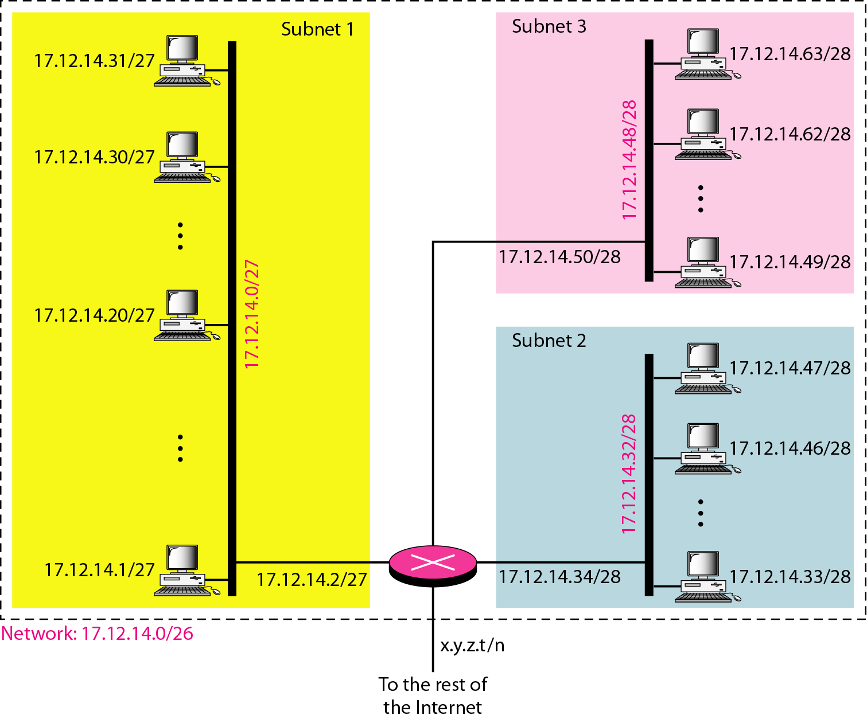
Figure 19.7 Configuration and addresses in a subnetted network

Slide 3
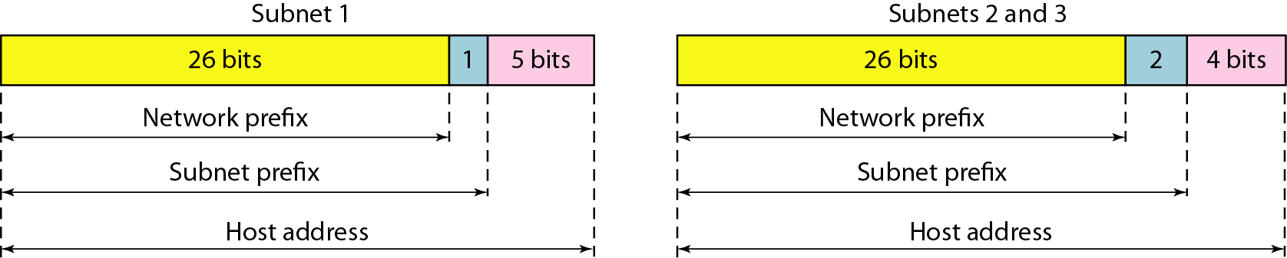
Figure 19.8 Three-level hierarchy in an IPv4 address

Slide 4
Problem
IP address
192.168.10.0 ------ Class C
Divide into 4 Subnetwork
11111111 . 11111111 . 11111111 . 11000000
Step1. Calculate Subnet bit required
Step2. Calculate updated subnet mask (255.255.255.192)
Step3. Find Range
Max subnet mask – updated subnet mask

Slide 5
Problem
192.168.10.0 ------ Class C
11111111 . 11111111 . 11111111 . 11000000
Step1. Calculate Subnet bit required
Step2. Calculate updated subnet mask (255.255.255.192)
Step3. Find Range
Max subnet mask – updated subnet mask
255.255.255.255
255.255.255.192
------------------------
0 0 0 63

Slide 6
Problem
192.168.10.0 ------ Class C
Max subnet mask – updated subnet mask
255.255.255.255
255.255.255.192
------------------------
0 0 0 63
192.168.10.0 --------------192.168.10.63
192.168.10.64-------------192.168.10.127
.128----------- .191
.192 ---- .255

Slide 7
Problem
192.168.10.0 ------ Class C
11111111 . 11111111 . 11111111 . 11100000
Step1. Calculate Subnet bit required
Step2. Calculate updated subnet mask (255.255.255.224)
Step3. Find Range
Max subnet mask – updated subnet mask
255.255.255.255
255.255.255.224
------------------------
0 0 0 31

Slide 8
Problem
192.168.10.0 ------ Class C
11111111 . 11111111 . 11111111 . 11100000
Max subnet mask – updated subnet mask
255.255.255.255
255.255.255.224
------------------------
0 0 0 31
192.168.10.0 -------192.168.10.31 Gateway Address 192.168.10.1
192.168.10.32 -------192.168.10.63 Gateway Address 192.168.10.33
192.168.10.64 -------192.168.10.95 Gateway Address 192.168.10.65
192.168.10.96 -------192.168.96.127
………………………………………….

Slide 9
